Slide 1
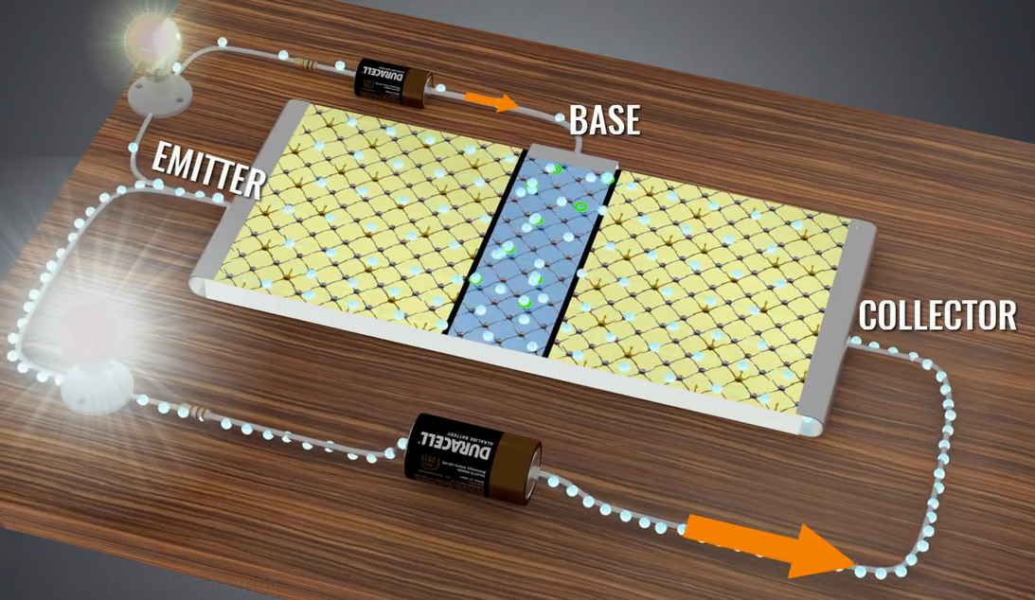


Analog Circuits
模拟电路
Qingfeng Zhang 张青峰
Department of Electrical and Electronic Engineering

Slide 2
0. Introduction
0.1 The development of electronics
0.2 Analog v.s. Digital
0.3 Learning Approach

Slide 3
0.1 Electronics
Electronics?
Science and technology that focus on electronic devices, circuits and applications
电子技术就是研究电子器件、电子电路及其应用的科学技术。
What is the most important component for a electronic system?
Amplifier -> small signal amplification
-> communication + sensing

Slide 4
The modern electronic science and technology is an interdiscipline(交叉学科)of materials, physics and devices.

Slide 5
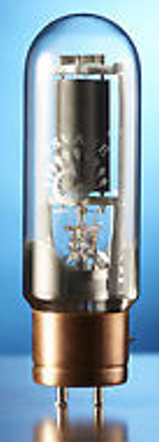
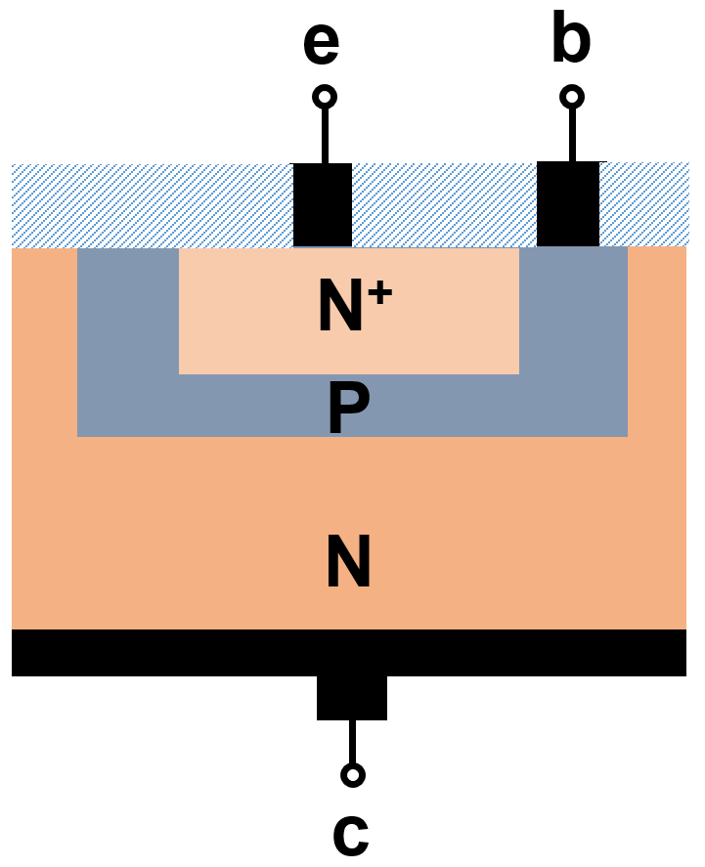
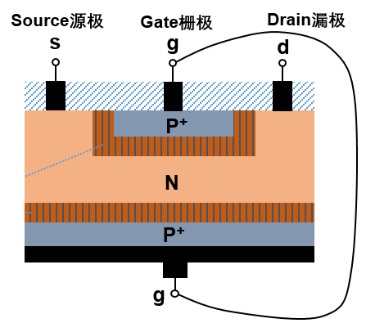
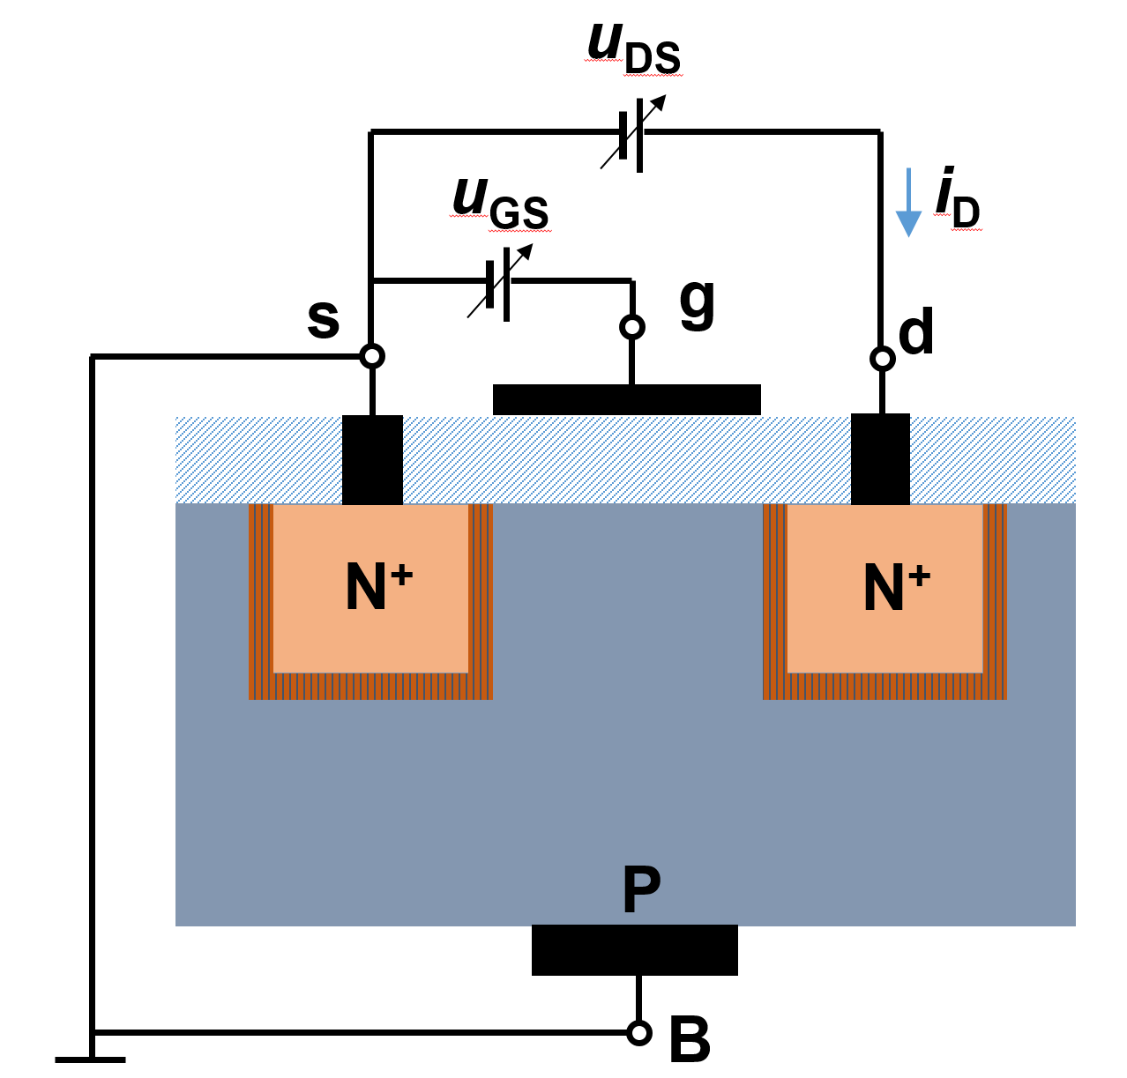
One example: the development of transistors
1950,
Junction field-effect transistors (JFET)
1904,
Vacuum tube
1947,
Transistor (BJT)
New device design
Physics: field effect
Heated cathode emit electrons
Material: Silicon, Germanium
1959,
Metal-oxide-semiconductor FET (MOSFET)
Device: N⁺PN. P⁺NP
Physics: PN junction

Slide 6


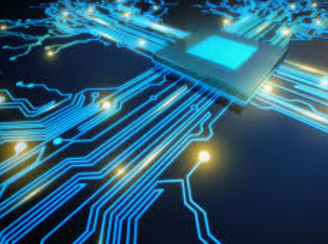
21th century: Electronic and Information World
Electronics changes our world and life in every aspects.

Slide 7
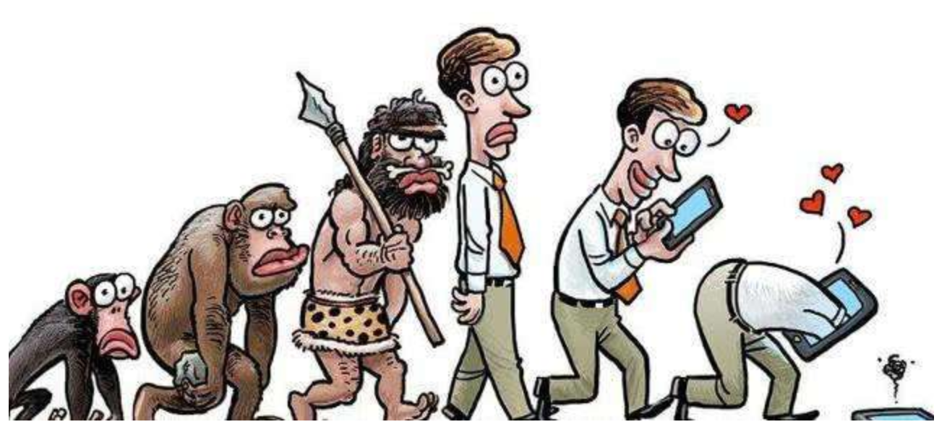
The evolution of human

Slide 8


Human = A pile of code in future?

Slide 9
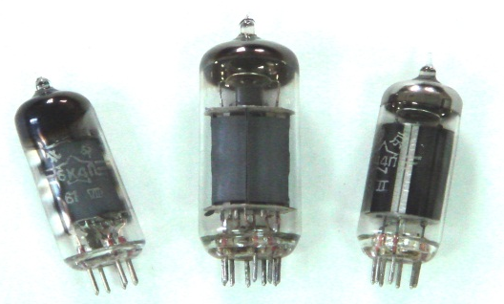
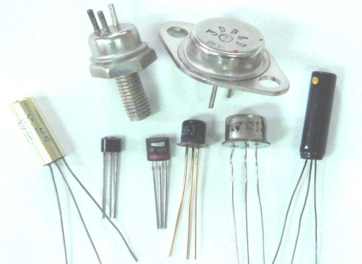
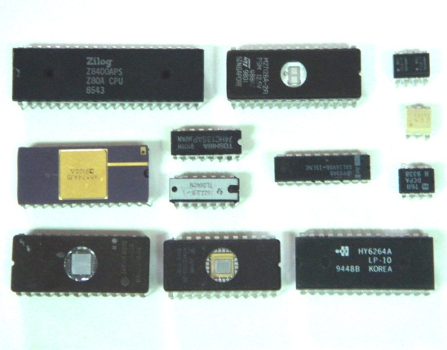
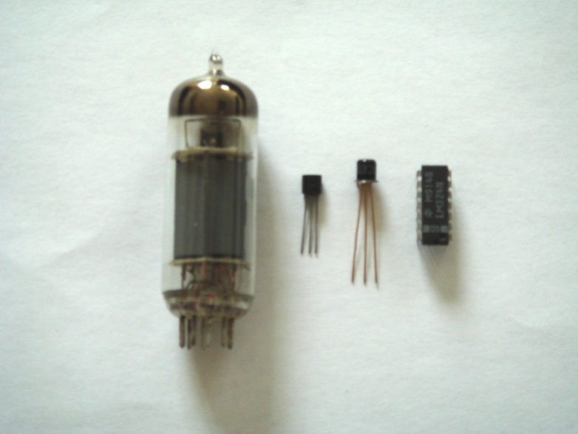
Development of electronic device
1904,
Electronic tube,电子管
1947,
Transistor,晶体管
1959,
Integrated circuit集成电路
Comparison of electronic tube, transistor, integrated circuit
电子管、晶体管、集成电路比较

Slide 10
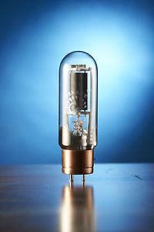
Vacuum tube
1st generation electronic device
第一代电子器件
Electronic (vacuum) tube
电子管（真空管）
a. Vacuum shield
b. Cathode 阴极
c. Heated cathode will emit electrons阴极可由灯丝加热，使温度升高，发射出电子
d. Current: Electrons motion under the electric field and magnetic field电子受外加电场和磁场的作用下，在真空中运动就形成了电子管中的电流

Slide 11
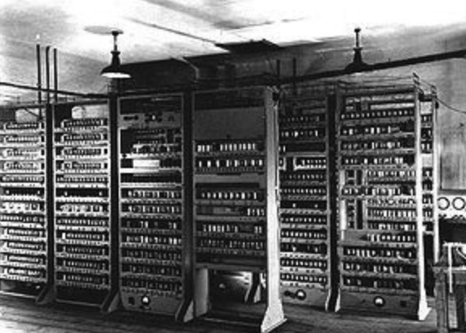
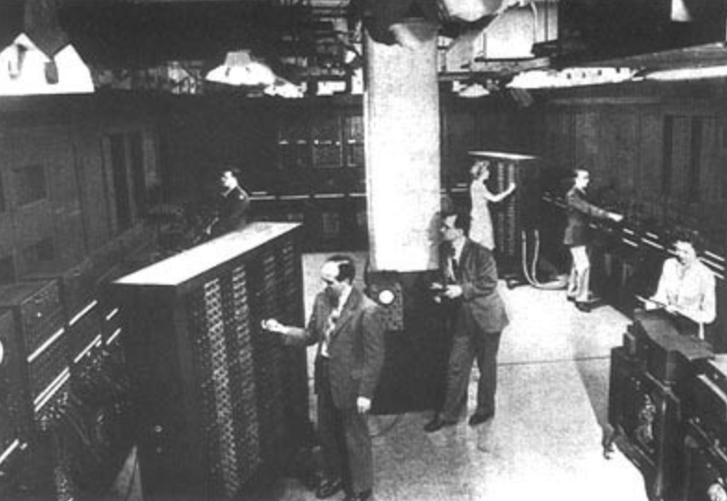
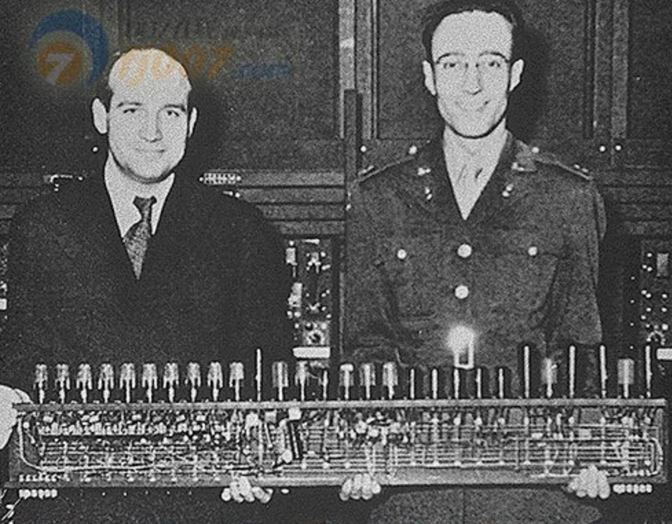
Vacuum tube
1st computer is made of vacuum tube
The ENIAC was invented by J. Presper Eckert and John Mauchly at the University of Pennsylvania and began construction in 1943 and was not completed until 1946.
Length: 50 feet; Width: 30 feet; Area: 1500 feet²; Weight: 30 ton; Power consumption: 170 kW; 18000 vacuum tubes; Every 15min, one vacuum tube breaks; 据传每 ENIAC 每次一开机，整个费城西区的电灯都为之黯然失色。
In one second, it processes 5000 times plus/minus calculation or 500 times multiplication calculation.

Slide 12
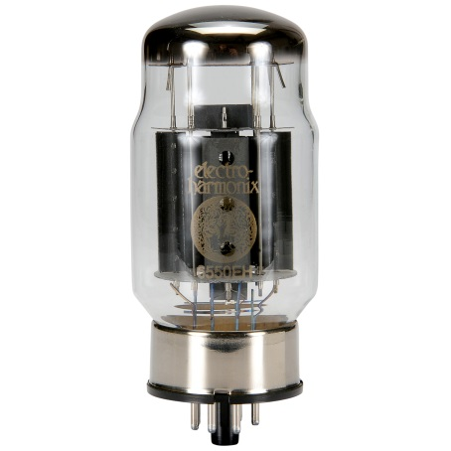
Vacuum tube
The disadvantage of vacuum tube：
Big, heavy, power consumption and short lifespan
体积大、重量重、耗电大、寿命短

Slide 13
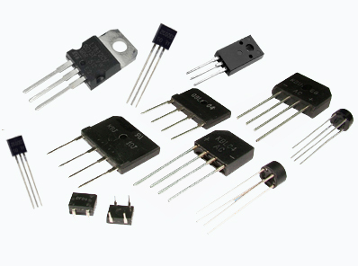
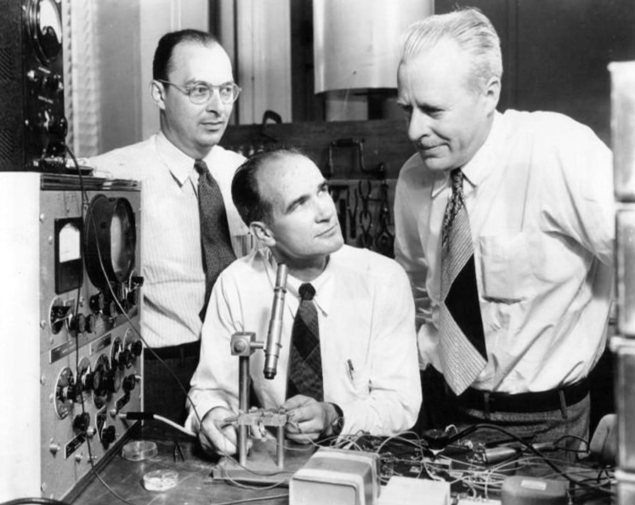
Transistor
2nd generation electronic device-- transistor
晶体管
1948, Bell Lab
Transistor is made of semiconductors(半导体)
John Bardeen (1908-1991), Walter House Brattain(1902-1987), and William Shockley (1910-1989)

Slide 14
John Bardeen
Born in USA in 1908，attend university at 16，interest in Physics.
He won Nobel Physics Prize twice
1956 for inventing transistors (Bardeen, Shockley, Brattain)
1972 for the BCS superconducting theory (Bardeen, Cooper, Schrieffer)

Slide 15
Transistor
Advantages:
a. Small & light
b. Long lifespan
c. Low power consumption
Disadvantages:
c. Sensitive to temperature
d. Poor overload capacity

Slide 16
Electronic circuit 电子电路
An electronic circuit is constructed through connecting electronic devices with resistors, inductors, capacitors, switches etc. to realize certain functions.
电子器件与电阻器、电感器、电容器、变压器、开关等元件适当地连接起来所组成的具有特定功能的电路。

Slide 17

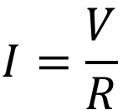
Electronic circuit
Difference compared with the ordinary circuit
a. Electronic devices (diode, transistor)
b. Non-linear characteristics
I
I-V curve of a transistor
V
R
V
$$I=\frac{V}{R}$$
Linear circuit
Non-linear

Slide 18
Electronic circuit
Discrete circuit
分立电路
Integrated circuit
集成电路

Slide 19
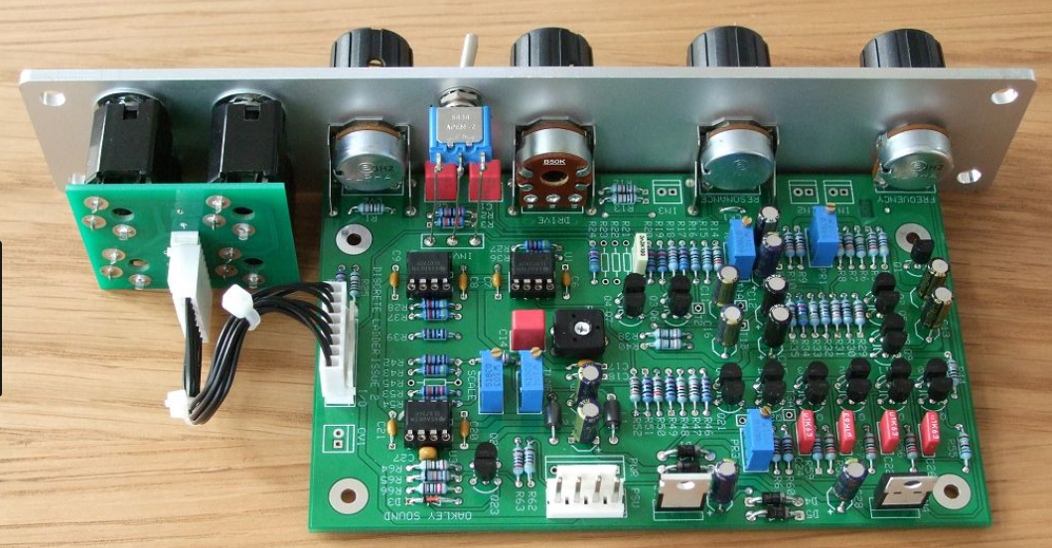
Discrete circuit
The electronic devices, resistors, capacitors and inductors are welded to the circuit board 把许多元件和器件焊接在印刷电路板上组成的
Large size，High power consumption，Low reliability

Slide 20
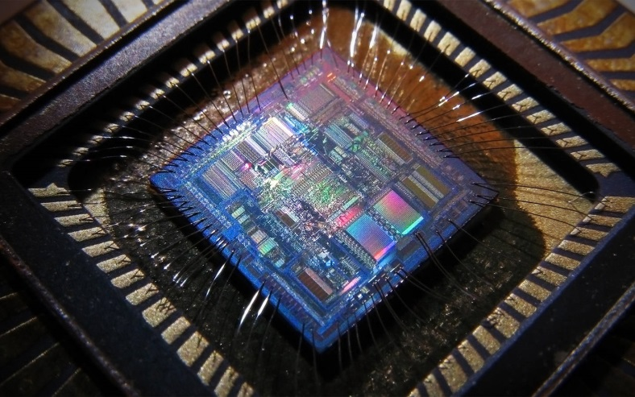
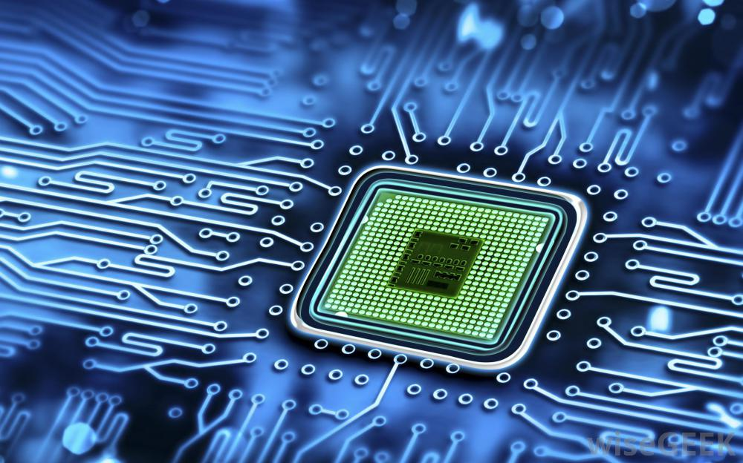
Integrated circuit-- IC
Integration of electronic devices (transistors) and components (resistors) on a single silicon chip
Advantages:
a. Small & light
c. Liability
b. Low power consumption
d. Long lifespan

Slide 21
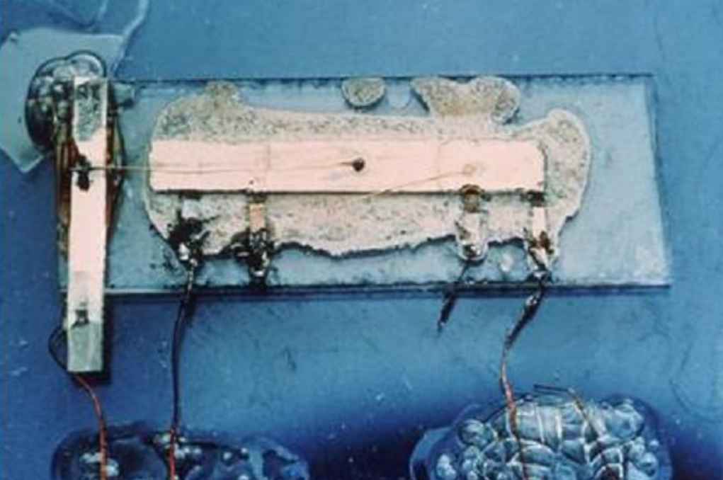
Development of integrated circuit
The first IC is invented by Jacky Kilby in Texas Instruments in 1959
Only 4 transistors on germanium slab
Nobel prize in Physics, 2000
7/16 x 1/16 inch
(1) Small scale integration , SSI
小规模集成电路
Integration level: several tens of devices per chip
集成度：一块芯片上集成有几十个元器件。

Slide 22
Development of integrated circuit
(2) Medium scale integration , MSI
中规模集成电路
Integration level: several hundreds of devices per chip
(3) Large scale integration , LSI
大规模集成电路
Integration level: several thousands/tens-of-thousands of devices per chip
(3) Very large scale integration , VLSI
超大规模集成电路
Integration level: > several hundreds of thousands of devices per chip

Slide 23
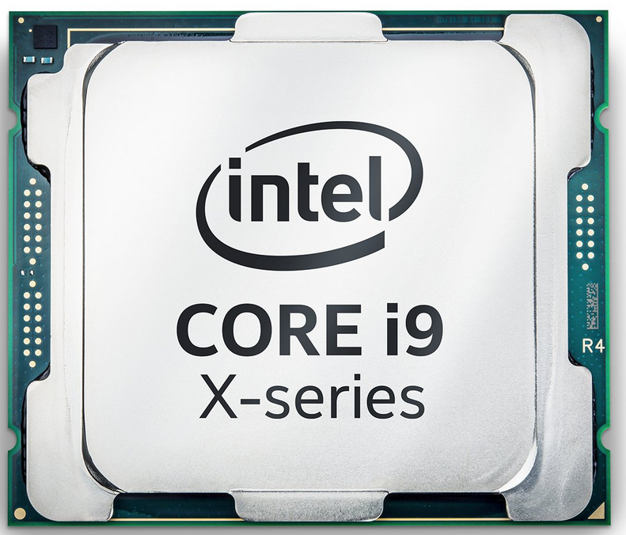
Development of integrated circuit
（5） State-of-the-art of IC
a. Over one hundred million devices per silicon chip
b. Very high speed and low power consumption

Slide 24
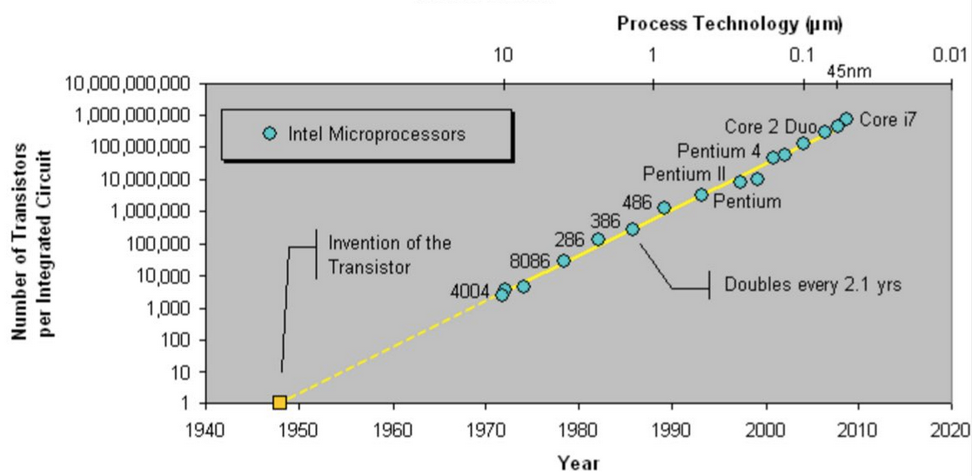
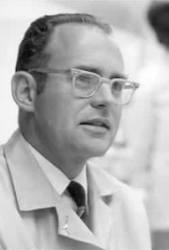
Development of integrated circuit
Moore’s law: number of transistors per IC doubles every two years
Development is slower after 2013
State-of-the-art transistor length is ~10 nm: only several tens of atoms

Slide 25
A schematic of short-channel transistor
10 nm
0.3 nm
The channel length $≈$ length of 33 atoms

Slide 26
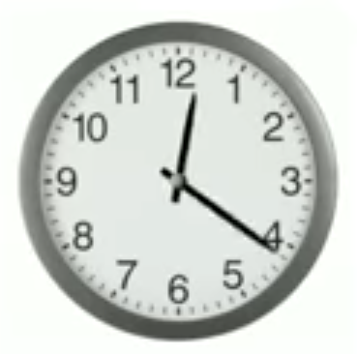
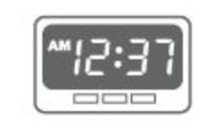
0.2 Analog vs Digital
Category of electronic circuit based on signal processing
Analog模拟
Digital数字
Signal is continuous
Signal is discrete
1
1
0
Device is in amplification mode
Device is in on/off mode

Slide 27
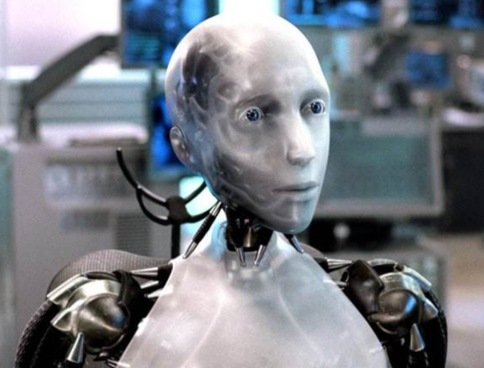
Signal 信号
Signal: what you see, what you hear, what you touch…
Q: Signal in nature is continuous or discrete?

Slide 28
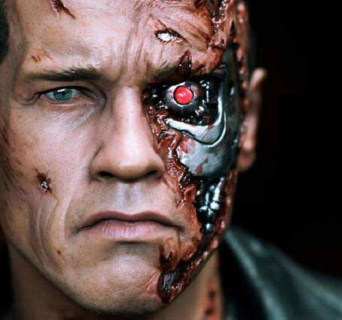
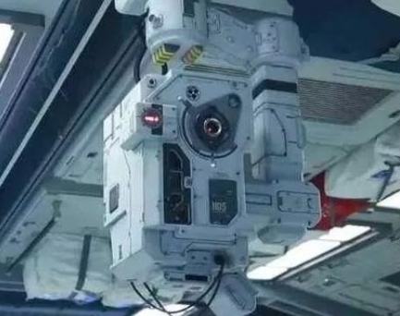
Electronic information system
A/D converter
Computer or other digital system
D/A converter
Signal detection
Signal processing
Signal operation
Signal drive and execution
Analog system

Slide 29



About this course
Interesting
A lot of interesting devices and circuits.
Analog Circuit
Important
Difficult
The core course for electronics.
Too many concepts, devices, circuits, applications…

Slide 30
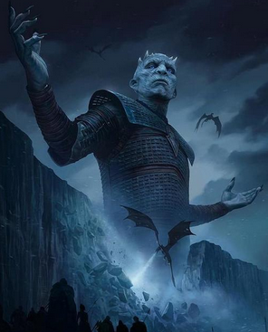

It’s demon circuits!
魔鬼电路!

Slide 31



If you have enough will and determination,
you can SUCCEED!
Good Luck!

